Slide 1
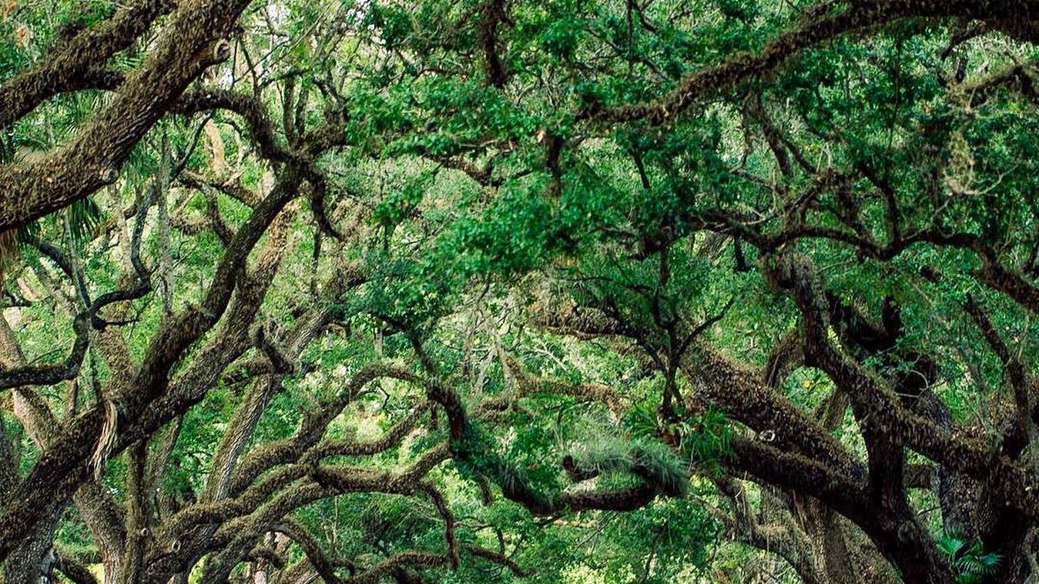
A Signature Miami Experience
Curated for a VIP guest, party of four. Palmetto Grand Resort and Spa.
Prepared by Elizabeth Robles, Senior Concierge

Slide 2
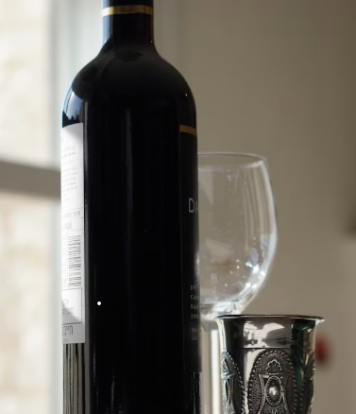
The Brief
What this guest is really asking for
Read the guest, not just the request.
• Four nights in an oceanfront penthouse, arriving on a Thursday
• Waterfront dining every evening, privacy over being seen
• One guest in the party avoids shellfish entirely, no exceptions
• Seamless private transport, airport to suite to every reservation
• A half day on the water, calm and unhurried, catering aboard
• A personal shopping afternoon before departure
Palmetto Grand Resort and Spa | Concierge Desk

Slide 3
Four Days, Designed
A rhythm of arrival, escape, celebration, and farewell
Thursday
Friday
Saturday
Sunday
Arrival
On the water
Restore
Farewell
Private car at the gate, chilled Albarino in suite. Waterfront table for four at eight, shellfish noted.
Half day private yacht, crew of two, catering by request. Open fire chef counter that evening.
Couples spa in the two quietest rooms. A held table and bottle service for a later night out.
A slow morning, personal shopping with a briefed stylist, then a private transfer to the airport.
All confirmations routed through the concierge desk

Slide 4

On the Water and at the Table
A short, vetted list, held with notice
Dining, by mood
• Bayfront Beach Club, sunset and easy elegance
• Fuego Parrilla, open fire, a real occasion
• Habana Vieja, the classic Cuban table
• A held South Beach room for a late night
On the water and beyond
• Sixty two foot motor yacht, crew of two
• Sunset bay tour or a run to the Keys
• Couples spa, rooms four and five
Vendors held to allergy aware standards, no shellfish aboard

Slide 5
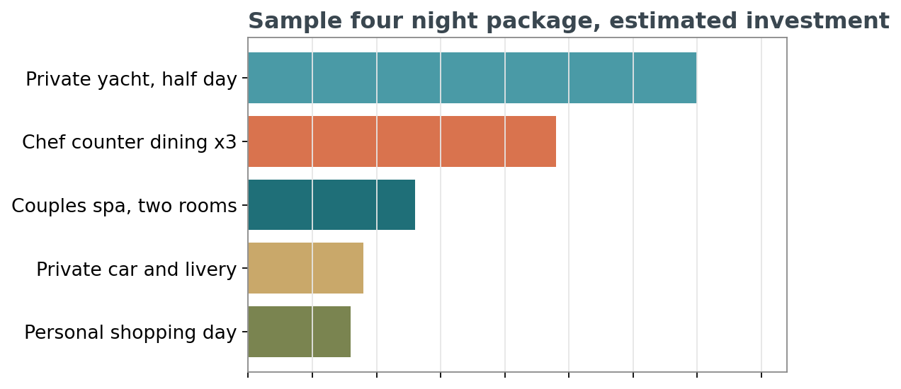
The Investment
Transparent, itemized, suite billed separately
$8,900
Estimated experience total, four nights, excluding suite and gratuities
$1,640
Comparable Havana family package, for scale
Every line is sourced from vetted vendors and confirmed before arrival. Adjustments are simple once we know the party.
Figures are estimates for planning and may shift with season

Slide 6
Why This Desk
Sixteen years of getting the details right
16 yrs
4.9 / 5
End to end
On property, most senior of six concierges
Average VIP guest satisfaction, FY2025
From yacht charters to the quiet table no one else can get
Tell me the kind of night you want, not just where you want to go, and I will get the rest right.
Elizabeth Robles, Senior Concierge. Direct line (305) 555-0118.
Palmetto Grand Resort and Spa, 1800 Oceanfront Promenade, Miami Beach, FL 33139

